Slide 1
The Coco-Cola
Company
An American corporation founded in 1892
@shreya_sonalinkedrnc

Slide 2
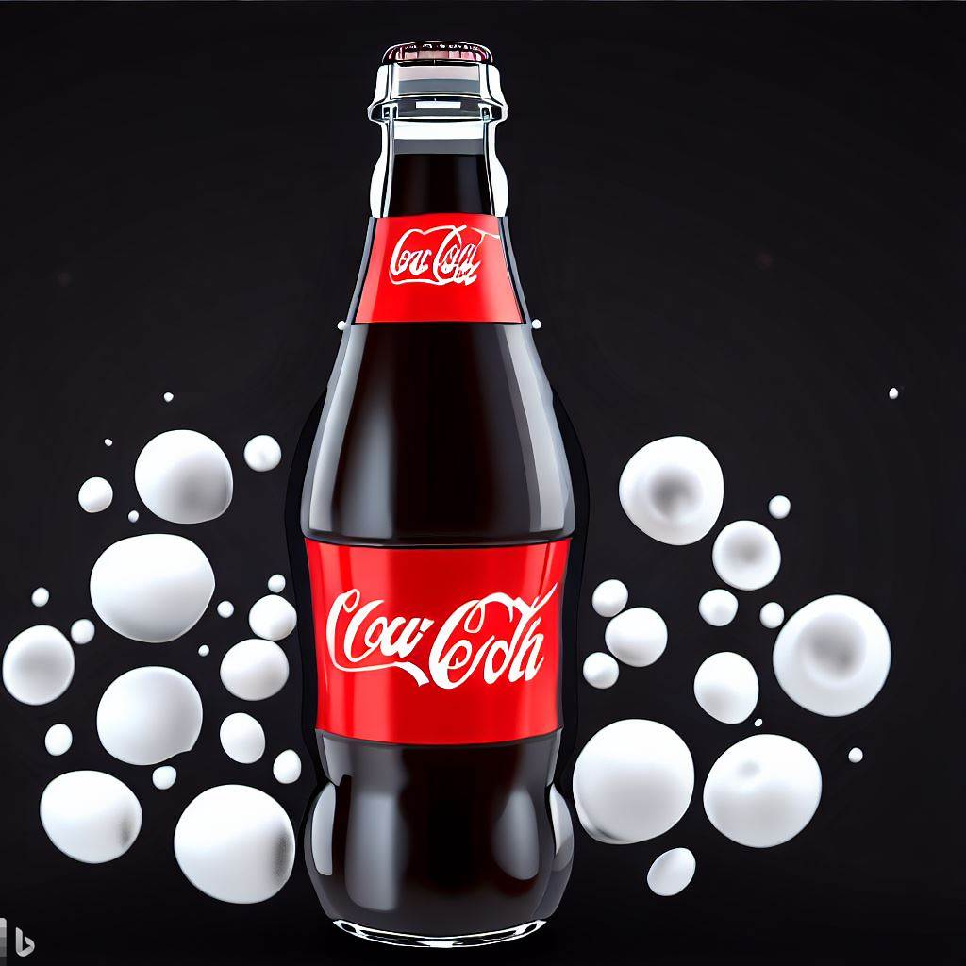
The Coco-Cola
Company
@shreya_sonalinkedrnc

Slide 3




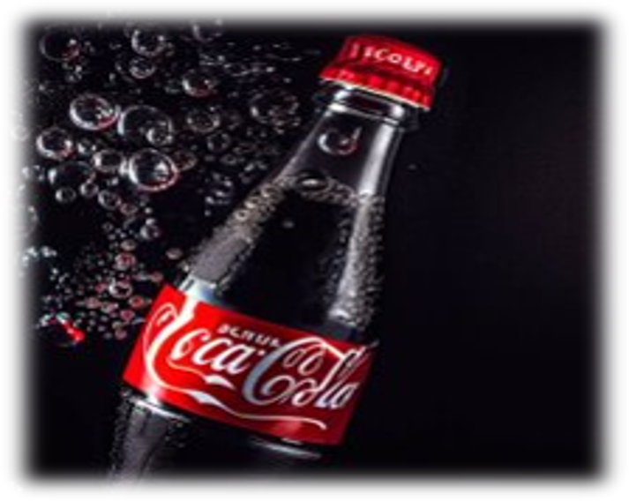
The Coco-Cola
Company
The Iconic
The Growth
The Current Company
The Origin
@shreya_sonalinkedrnc

Slide 4
The Coco-Cola
Company
The Origin
@shreya_sonalinkedrnc

Slide 5
The Coco-Cola
Company
The Origin
•-Invented by John S. Pemberton in 1886
•-First sold at Jacobs' Pharmacy in Atlanta
•-Originally marketed as a tonic for common ailments
•-Contained cocaine from coca leaf and caffeine from kola nut
•-Cocaine was removed from the formula in about 1903
@shreya_sonalinkedrnc

Slide 6
The Coco-Cola
Company
The Growth
@shreya_sonalinkedrnc

Slide 7
The Coco-Cola
Company
The Growth
•-Acquired by Asa Griggs Candler in 1891 for $2,300
•-Incorporated in 1892 and registered trademark in 1893
•-Sales rose from 9,000 gallons of syrup
in 1890 to 370,877 gallons in 1900
•-Expanded to international markets
in the early 20th century
•-Introduced new products and brands
such as Fanta, Sprite, Minute Maid, etc.
@shreya_sonalinkedrnc

Slide 8
The Coco-Cola
Company
The Iconic
@shreya_sonalinkedrnc

Slide 9
The Coco-Cola
Company
The Iconic
•-Designed by the Root Glass Company in 1915
•-Inspired by the shape of the cocoa pod
•-Intended to distinguish Coca-Cola from its competitors
•-Became a symbol of American culture and lifestyle
•-Celebrated in art, music and advertising
@shreya_sonalinkedrnc

Slide 10
The Coco-Cola
Company
The Current Company
@shreya_sonalinkedrnc

Slide 11
The Coco-Cola
Company
The Current Company
•-Headquartered in Atlanta, Georgia
•-Produces and sells more than 2,800 products in more than 200 countries
•-One of the largest beverage
manufacturers and distributors in
the world
•-One of the most successful brands in marketing history
•-Committed to sustainability and social responsibility
@shreya_sonalinkedrnc

Slide 12
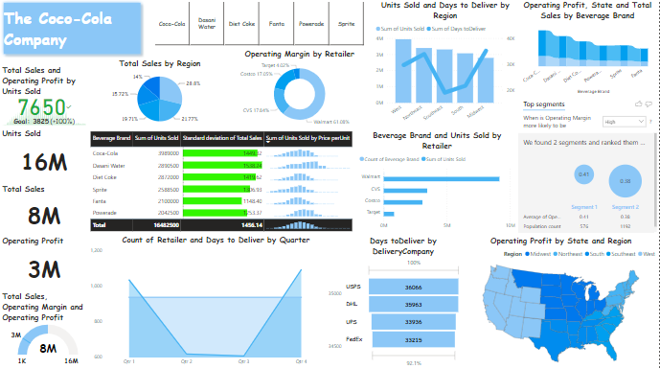
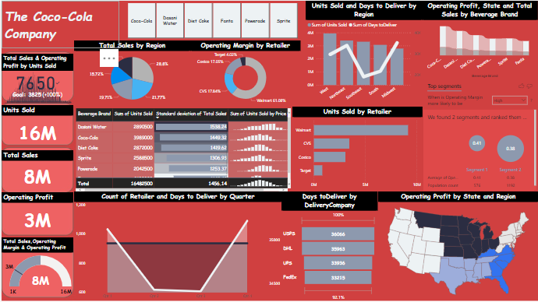
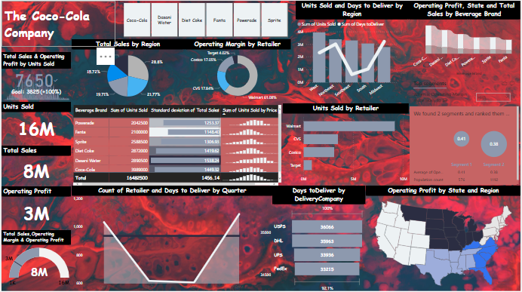
R
E
P
O
R
T
@shreya_sonalinkedrnc

Slide 13
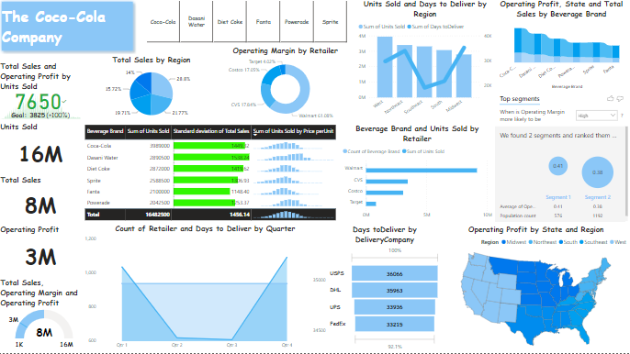

Basic report generated with the help of
Power Bi inbuilt formatting options.
Basic Report
@shreya_sonalinkedrnc

Slide 14
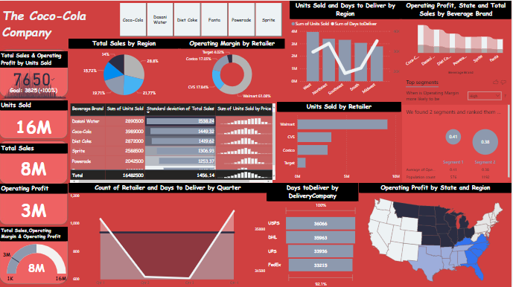
Colored report
generated with the help of Power Bi inbuilt formatting and adding colors as per our choice to the Canvas.​
Colored Report
@shreya_sonalinkedrnc

Slide 15
Dramatic report generated with the help of Power Bi inbuilt
formatting
options, also creative Canvas background formatting.
Dramatic Report
@shreya_sonalinkedrnc

Slide 16
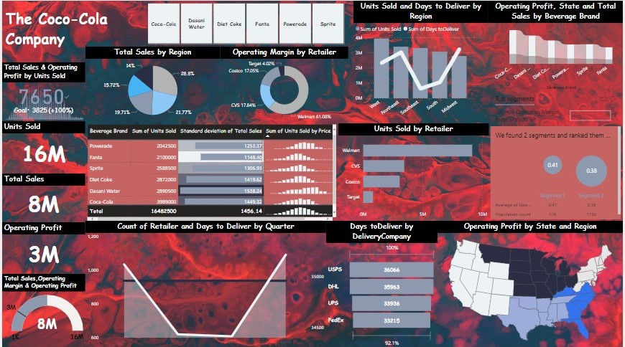
@shreya_sonalinkedrnc

Slide 17

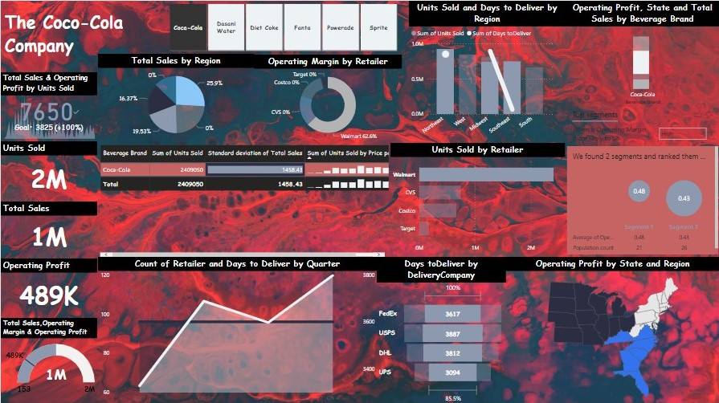
Coco-Cola is the maximum in demand beverage from
'The Coco-Cola Company'
with respect to the Walmart retailer having most of the units sold in the market with an operating margin of 62.6% and operating profit of 489K.
@shreya_sonalinkedrnc

Slide 18
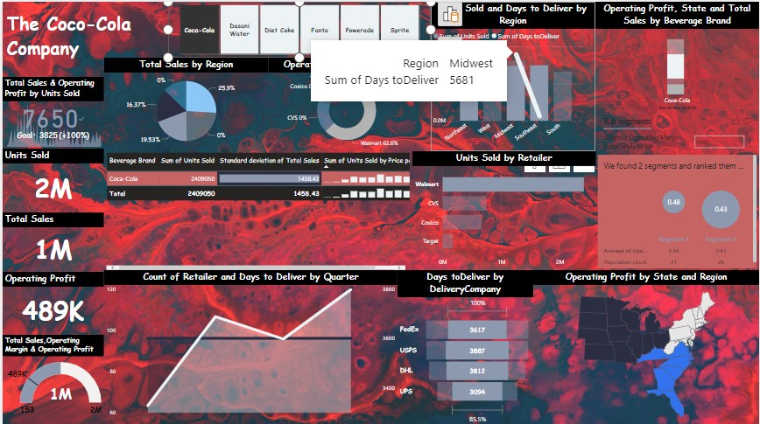
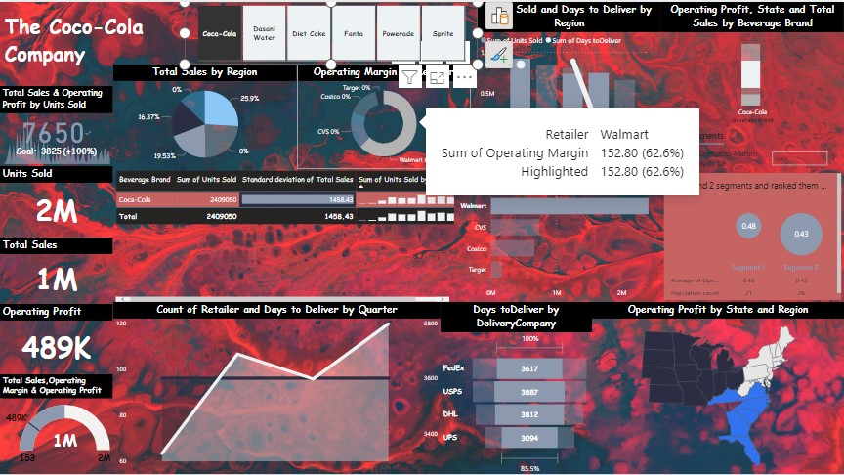
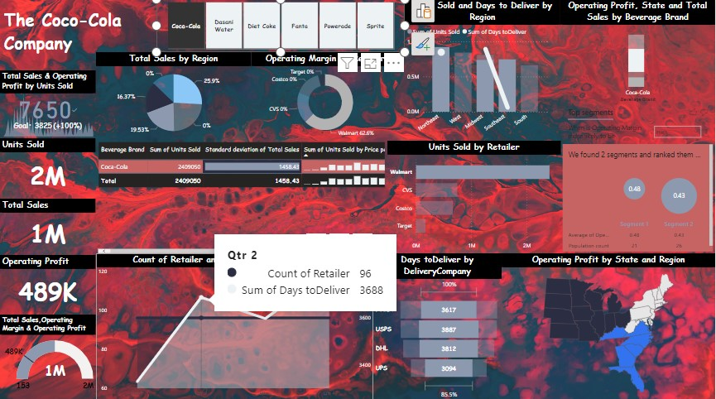
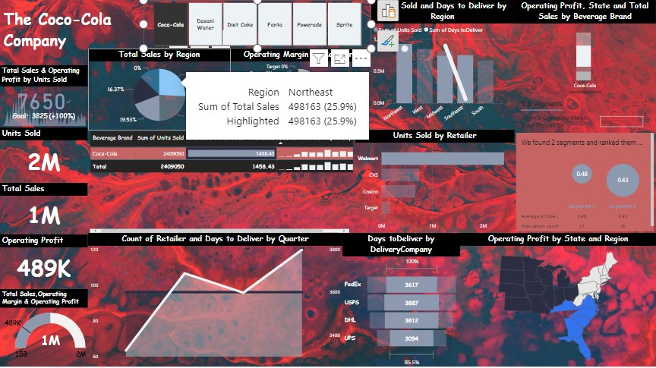
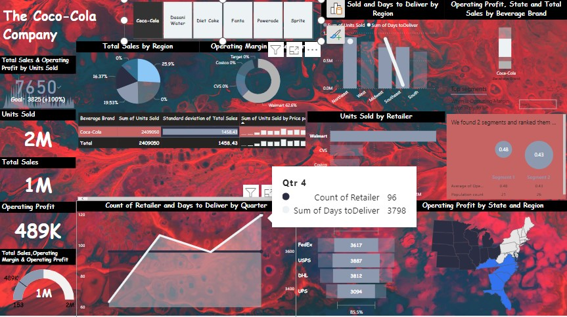
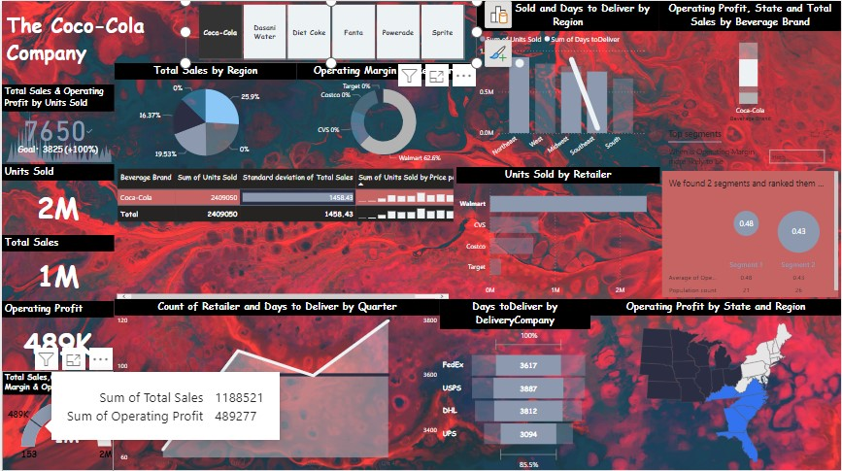
@shreya_sonalinkedrnc

Slide 19
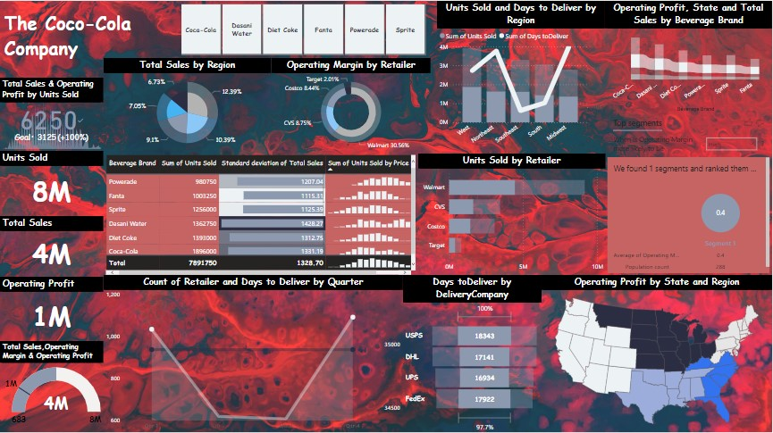
In this slide, we be looking at the different break downs of each graph with respect to the
Q1 to Q4 transitions.
Also, the next slide represents us the Analysis of the delivery company and retailer wise distributions
respectively.
@shreya_sonalinkedrnc

Slide 20

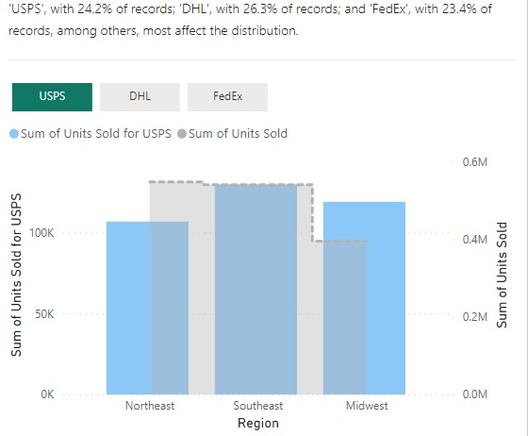
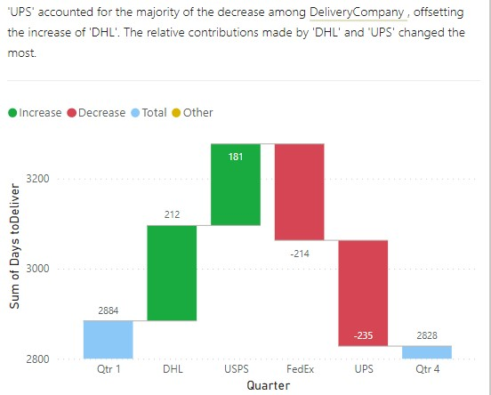
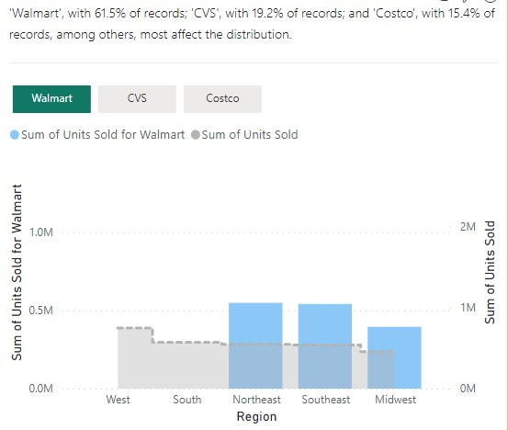
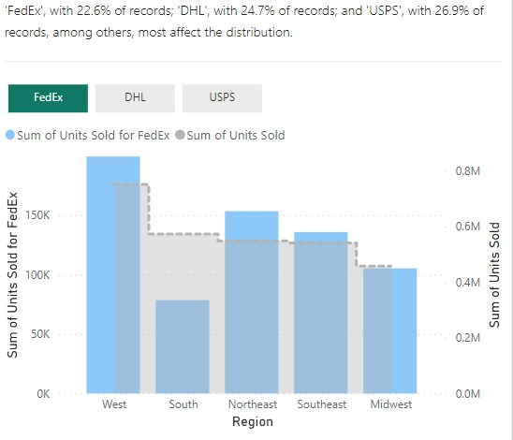
@shreya_sonalinkedrnc

Slide 21
AI Tools
YouTube
Power Point Presentation
Excel
Power BI
@shreya_sonalinkedrnc

Slide 22
The End
Thank you!!
A power point presentation by
Shreya Sonal 2023
@shreya_sonalinkedrnc

